Slide 1
Muzix Application
Presented By:
NIKHIL SHRIVASTAVA,
MOHAMMAD KAMRAN,
RAGHUNATH M

Slide 2
Introduction
Our Muzix application is nothing but a movie application.
This app is designed to see all the movies of various languages & genres.
This app uses a 3rd party API to fetch the movies.
This app is compatible with all devices like Desktop, Tablet, Mobile, etc…
In our app all movies are present including the latest movies .

Slide 3
Features of the App
See the movie info.
Search Any Movie.
Add to Favourites.
Delete from Favourites.
Recommended movies related to particular movie.

Slide 4
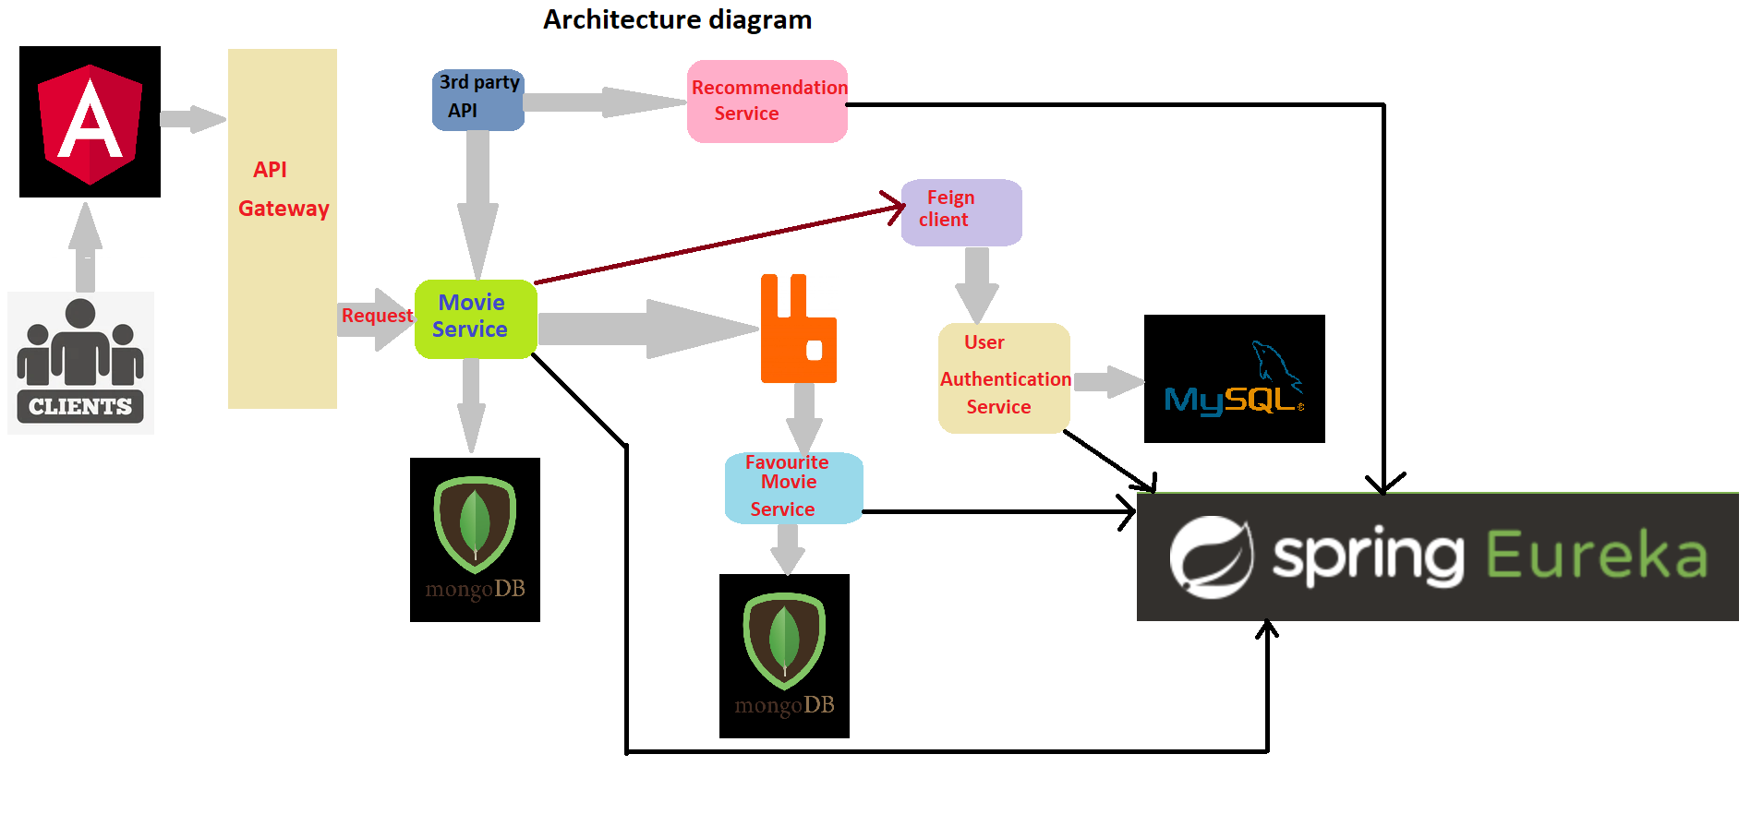

Slide 5
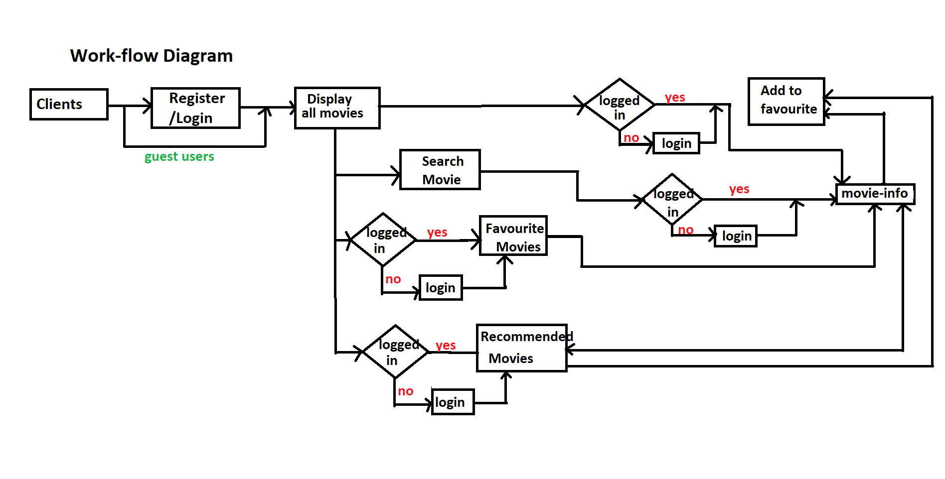

Slide 6
Tools & technology
BackEnd
Spring boot
Eureka Server
API Gateway
Feign Client
RabbitMQ
Docker
FrontEnd
Angular
Databases
MongoDB
MySQL

Slide 7
Thank You

